Slide 1


A Tour to Statistically Informed Interactive Maps
Researcher: Carina Zheng
Supervisor: Richard Penny
With Statistics NZ
2015/16
Notes:
Simple introduction
Time: 30 sec
Last updated on 18/2/16
At 10.01am

Slide 2

Motivation
Aim: To investigate and develop statistically informed methods to guide users who are not familiar with statistical methods.
Primary questions of interactive plots:
What are the good components and why?
What are the bad components and why?
In terms of statistics, how good and accurate are
online interactive graphs?
Project outline:
1. Get the feeling - See how others interactive plots look like,
how others users develop the plots,
what the feedbacks from users are like.
2. Experiment - Building our own application.
3. Draw our conclusion
Outline
Motivation
An Example
Background
Concept of the app
Reading Data
Preparation
Parameters
One-mean Table
One-mean Map
Two-mean Table
Scatterplot
Two-mean Map
Legend Comparison
A Little Taste
More to be done
The End
Notes:
Time: 2 min
2.30
There are many different types of interactive plots online. Therefore, We want to know how to make a user-friendly yet statistically accurate interactive plots which guide and encourage users to view the result in a statistical manner.

Slide 3
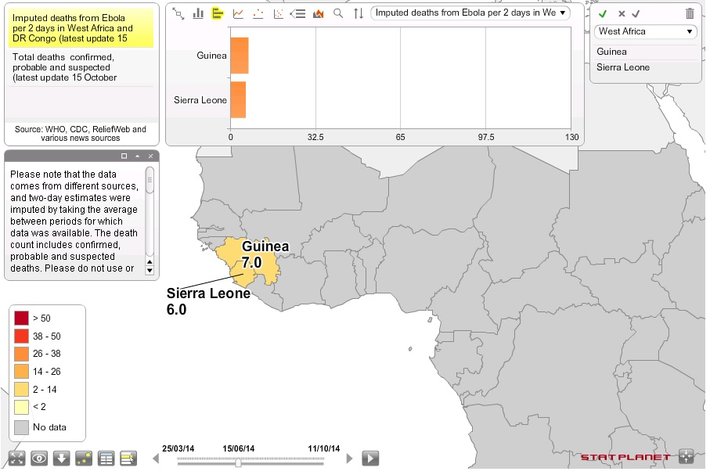
An example
Outline
Motivation
An Example
Background
Concept of the app
Reading Data
Preparation
Parameters
One-mean Table
One-mean Map
Two-mean Table
Scatterplot
Two-mean Map
Legend Comparison
A Little Taste
More to be done
The End
About this map, I think…
Good ☺
Many functions
Explanations and notes are available
Fancy looking
Bad ☹
Too much on one page
Top panel blocks part of the map
Now let’s start our project!
Map is retrieved from http://www.statsilk.com/maps/interactive-map-ebola-death-rate-west-africa-and-dr-congo-time-animation
Notes:
Time: 1.5min
4.00
Design aspect:
Stat aspect: Graph above is showing the difference between two selections

Slide 4
Background
Outline
Motivation
An Example
Background
Concept of the app
Reading Data
Preparation
Parameters
One-mean Table
One-mean Map
Two-mean Table
Scatterplot
Two-mean Map
Legend Comparison
A Little Taste
More to be done
The End
Source Data: From Statistics New Zealand, titled “Main means of travel to work, for the employed census usually resident population count aged 15 years and over, 2001, 2006, and 2013 Censuses (RC, TA, AU)”
-- data of year 2013 in Territory Authorities (TA) is being used here
Spatial files: ESRI shapefiles named “New Zealand 2013 (NZTM)”, in Census-based files section.
in Territory Authorities (TA)
Operating System: Windows
RStudio, version 0.99.489
R library: 3.2
Notes:
Time: 0.5 - 1 min
4.30-5.00
Brief explanation
Why we use TA, 2013

Slide 5
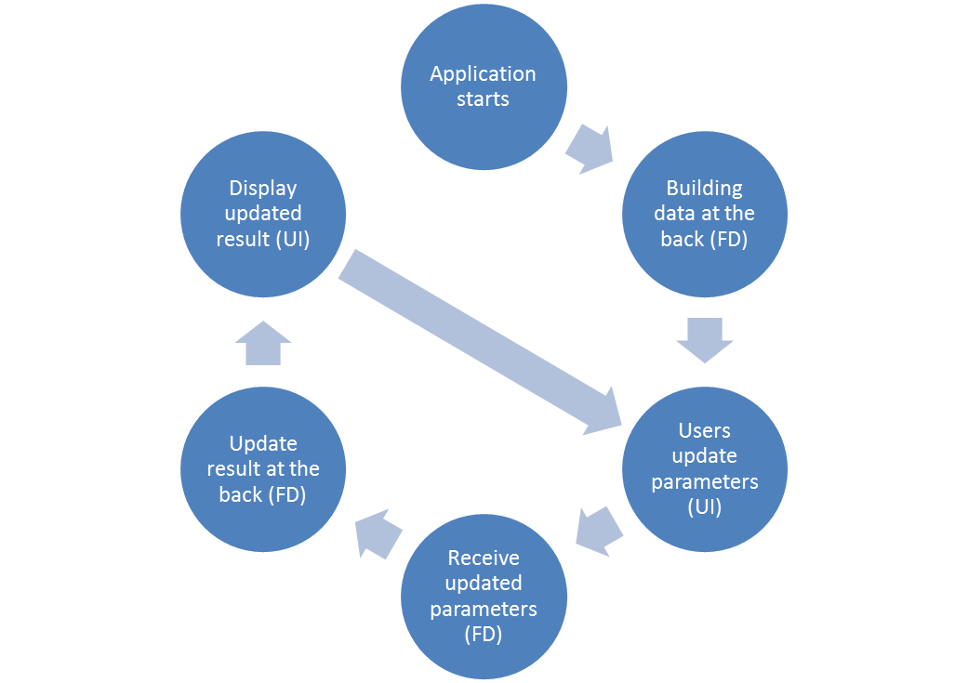
Concept of the app
Outline
Motivation
An Example
Background
Concept of the app
Reading Data
Preparation
Parameters
One-mean Table
One-mean Map
Two-mean Table
Scatterplot
Two-mean Map
Legend Comparison
A Little Taste
More to be done
The End
Notes:
Time: 1min
5.30
Explanation to processes
We are building a bridge between users and the computers here.

Slide 6
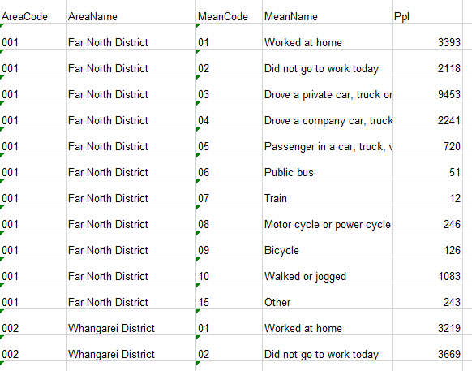
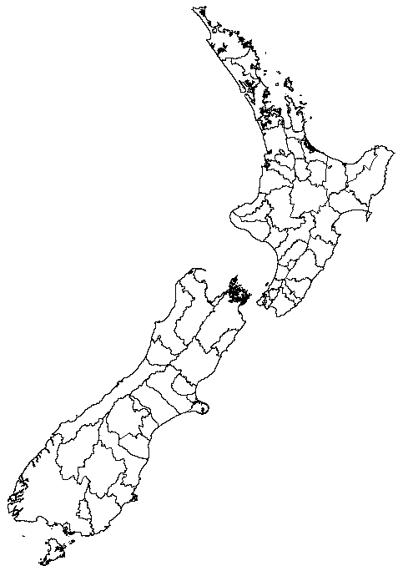
Reading data
Outline
Motivation
An Example
Background
Concept of the app
Reading Data
Preparation
Parameters
One-mean Table
One-mean Map
Two-mean Table
Scatterplot
Two-mean Map
Legend Comparison
A Little Taste
More to be done
The End
Reading the source data from csv file.
Generating list objects from the source data.
Reading the shapefiles into R. (maptools)
Merging the source data to shapefiles object.
Notes:
Time: 2min
7.30
In csv format for more stable data storing
List objects are used for later
Maptools
Excluding territorial authorities: Chatham Islands, Area Outside Territorial Authority.
no colours so no comparison can be made
manipulate the data by using the data attribute of the shapefiles object

Slide 7
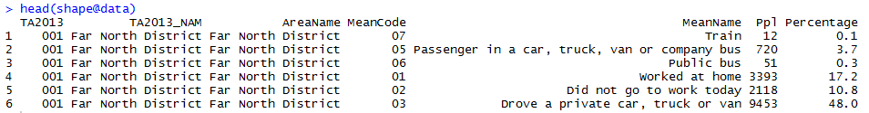
preparation
Outline
Motivation
An Example
Background
Concept of the app
Reading Data
Preparation
Parameters
One-mean Table
One-mean Map
Two-mean Table
Scatterplot
Two-mean Map
Legend Comparison
A Little Taste
More to be done
The End
Key method:
Calculating Percentages of travel means within territory authorities
Each percentage represents weight of a travel mean being chosen in a territory authority.
The numbers of people used specific travel means / total numbers of people in territory authorities
For example, there are 19,686 people from “Far North District" (a territory authority) involved in the research. 51 people chose "Public bus" (a travel mean) on the survey conducted day. Therefore, the percentage of "Public bus" in " Far North District" is calculated as
51/ 19,686 = 0.3 (1 decimal place)
Notes:
Time: 1.5min
9.00
We remain one decimal place in this research because having more decimal places would have the same effect yet it does not have a better reading.
calculation explanation:
the pie chart is sum to 100%
each travel mean has a percentage
11 travel means in total
Excluding means: 77 Response unidentifiable, 99 Not stated.
ppl used specific means / total ppl

Slide 8
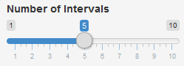
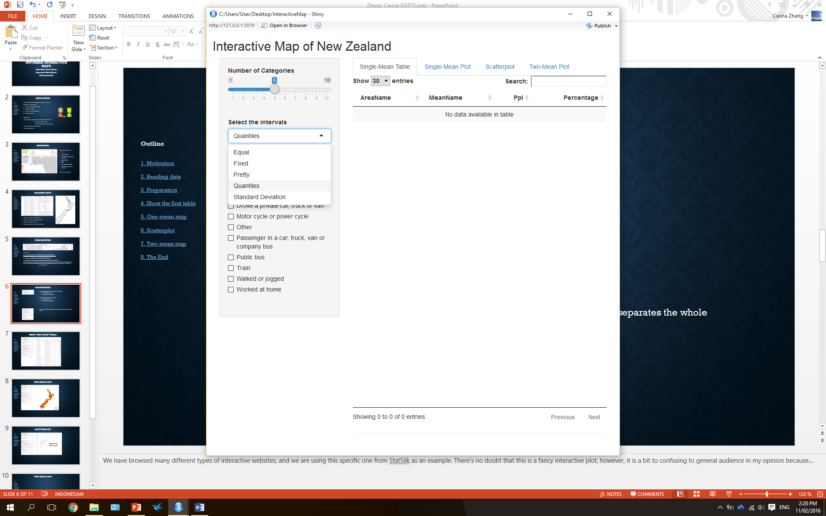
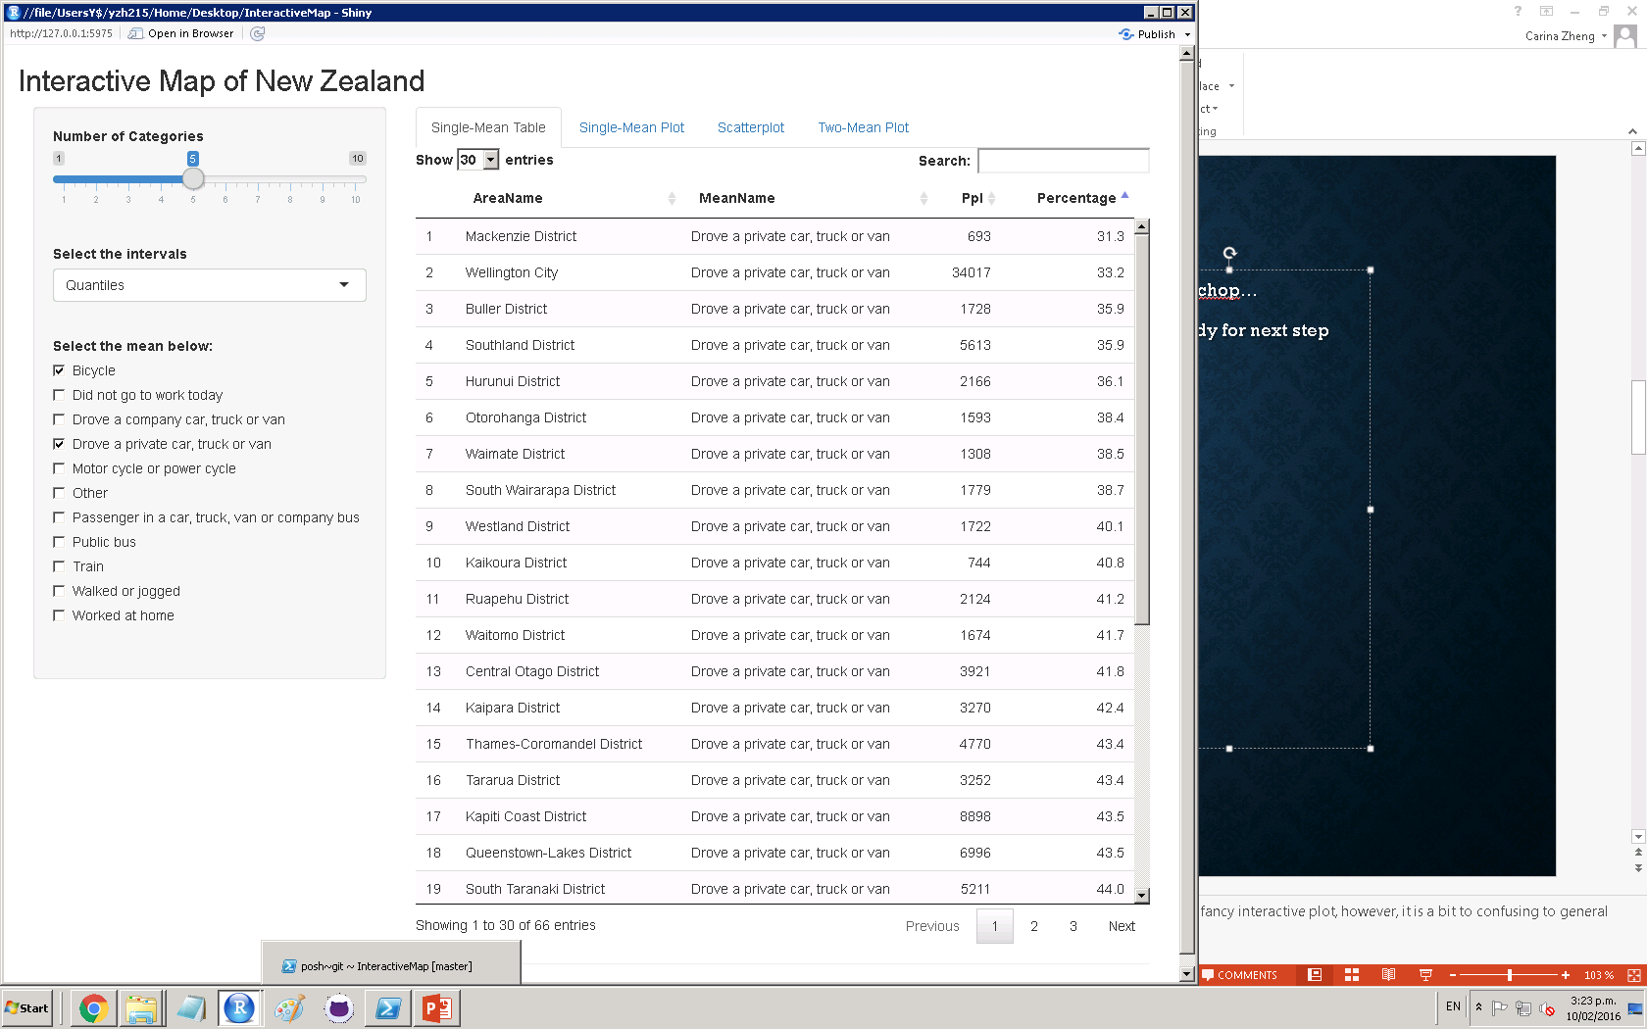
Parameters
Select the number of intervals which is used for:
Separating the full data.
Assigning color to each value.
Outline
Motivation
An Example
Background
Concept of the app
Reading Data
Preparation
Parameters
One-mean Table
One-mean Map
Two-mean Table
Scatterplot
Two-mean Map
Legend Comparison
A Little Taste
More to be done
The End
Select the interval style which is used for:
Separating the full data.
Assigning color to each value.
Select one travel mean to view, OR
Select two travel means to compare.
Notes:
Time: 2min
11.00
Categories: limit the arrange of the numbers quietly and politely
Intervals: Quantiles & SD are the only ones that could be more statistical (confusing to some users)
Pros and cons of these intervals
SD is a measure that is used to quantify the amount of variation or dispersion of a set of data values.
Quantiles are cutpoints dividing a set of observations into equal sized groups.
each quantile has same number of data points
Equal – each interval has same range difference
Means: only 11 means, enough space to be contained
Excluding means: 77 Response unidentifiable, 99 Not stated.

Slide 9
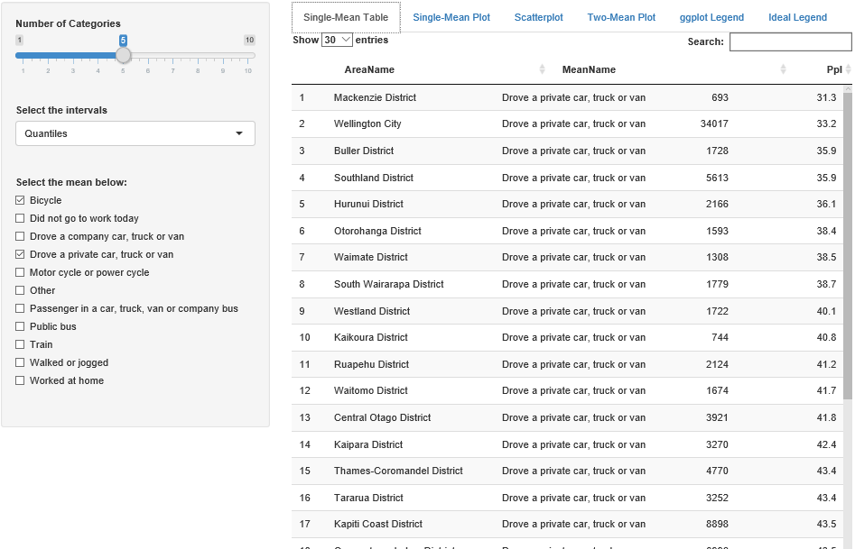
One-mean table
Outline
Motivation
An Example
Background
Concept of the app
Reading Data
Preparation
Parameters
One-mean Table
One-mean Map
Two-mean Table
Scatterplot
Two-mean Map
Legend Comparison
A Little Taste
More to be done
The End
Selecting the subset of the source dataset.
Mainly using Shiny package for User Interface building.
Detailed information is shown.
Not much visualization.
Notes:
Time: 1.5min
12.30
STAT:
Comparing the difference by visual (looking at the numbers)
Not much visualization can be made – this tab is only for users who want to go into details and compare the numbers
Tech:
Key concept is using the corresponding subset of the data
Shiny helps a lot
Table is refreshed automatically when mean is updated

Slide 10
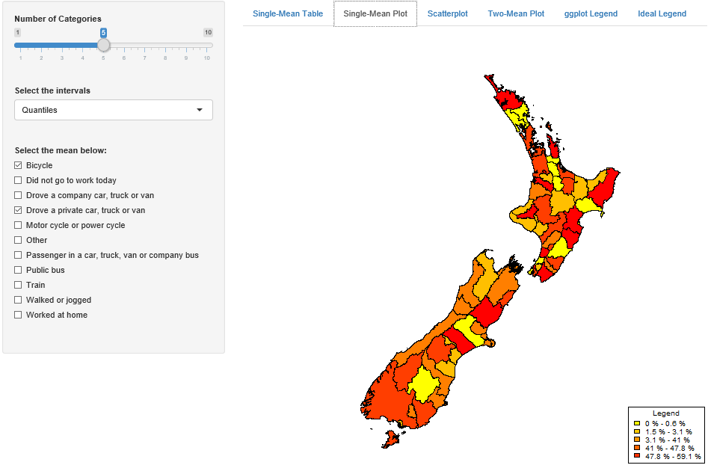
One-mean map
Basic Visualization
Limited Correlation
Key functions:
colorRampPalette {colorRamps}
classIntervals {classInt}
findColours – match each value in dataset to a color
Customized legend –
“%” after numbers
Beginnings of intervals are added
“-” are added
Outline
Motivation
An Example
Background
Concept of the app
Reading Data
Preparation
Parameters
One-mean Table
One-mean Map
Two-mean Table
Scatterplot
Two-mean Map
Legend Comparison
A Little Taste
More to be done
The End
Notes:
Time: 2min
14.30
Tech:
Assigning colours to TA by the percentages of specific mean
Plot the map in TA with assigned colours
Legend
interval
Stat:
Compare to the initial map in slide 6, it’s easier to identify the difference of TA by colours (visualization)
Correlation is only valid in terms of physical locations

Slide 11
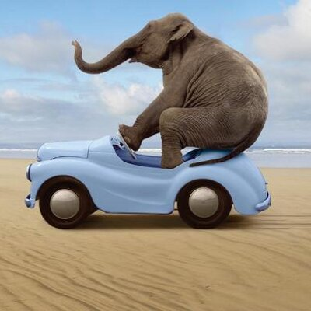
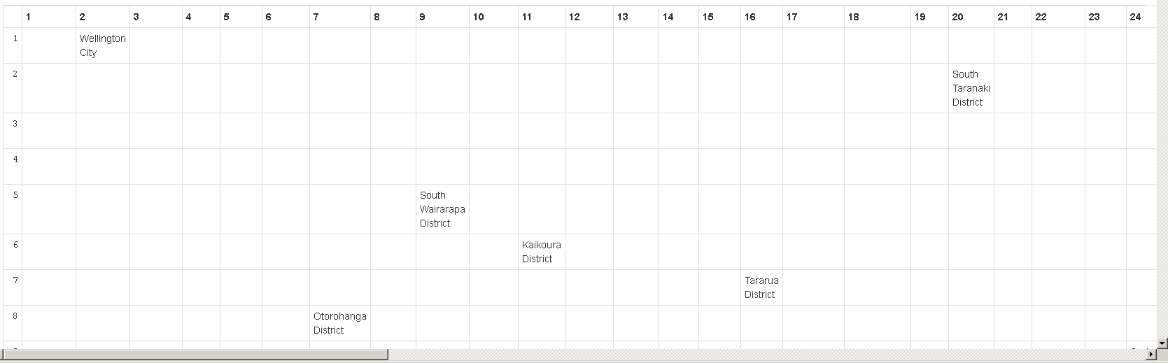
Two-mean table
Outline
Motivation
An Example
Background
Concept of the app
Reading Data
Preparation
Parameters
One-mean Table
One-mean Map
Two-mean Table
Scatterplot
Two-mean Map
Legend Comparison
A Little Taste
More to be done
The End
Eh… perhaps too much to be squeezed in?
Notes:
Time: 1.5min
16.00
STAT:
Initial concept is using the matrix to contain the data (TA names as values, x and y positions are the ranks). Users would be able to see if the TA tend to use one mean more than another.
However, given the number of the TA in this project (67), they can’t fit in one page and scrolling is required. Cons is users don’t have so much patience (cuz even myself didn’t read the table in details). So idea was abandoned.
TECH:
Rank the percentages in each mean in ascending order
The positions of means would determine the TA positions in matrix

Slide 12
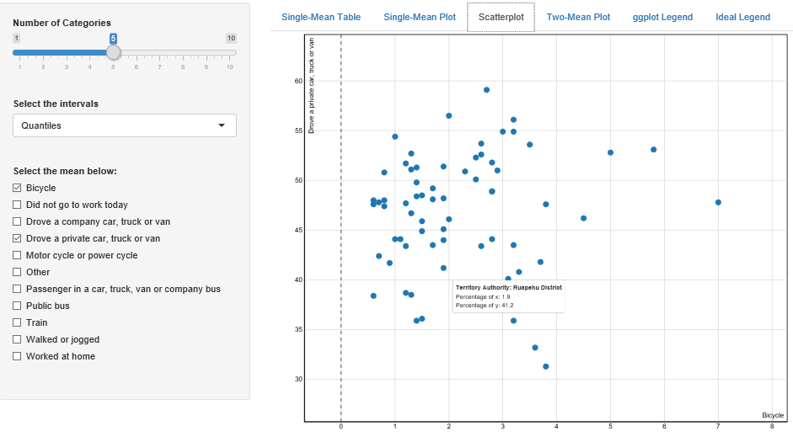
Scatterplot
Statistically speaking:
Better visualization
A rough correlation
Concept:
Rank the territory authorities by percentages in separate travel means. The ranks are the x and y positions of the data points.
Supply the dataset to key function scatterD3. It draws the interactive scatterplot.
Outline
Motivation
An Example
Background
Concept of the app
Reading Data
Preparation
Parameters
One-mean Table
One-mean Map
Two-mean Table
Scatterplot
Two-mean Map
Legend Comparison
A Little Taste
More to be done
The End
Notes:
Time: 1.5min
17.30
Stat:
Scatterplot Pros: correlations between travel means in the same TA
They can show large quantities of data and make it easy to see correlation between variables and clustering effects.
Cons: measurements are not accurate enough
Not showing possible variable that affects the correlation
Tech:
scatterD3

Slide 13
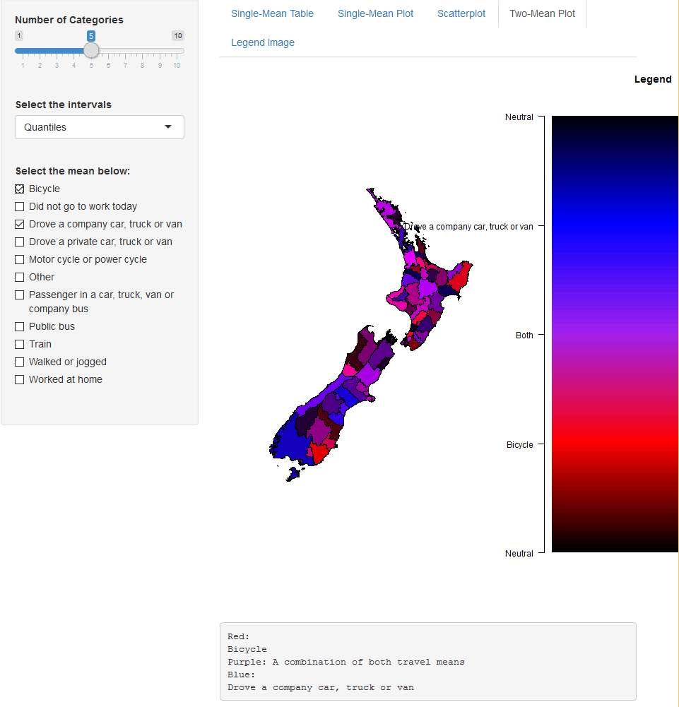
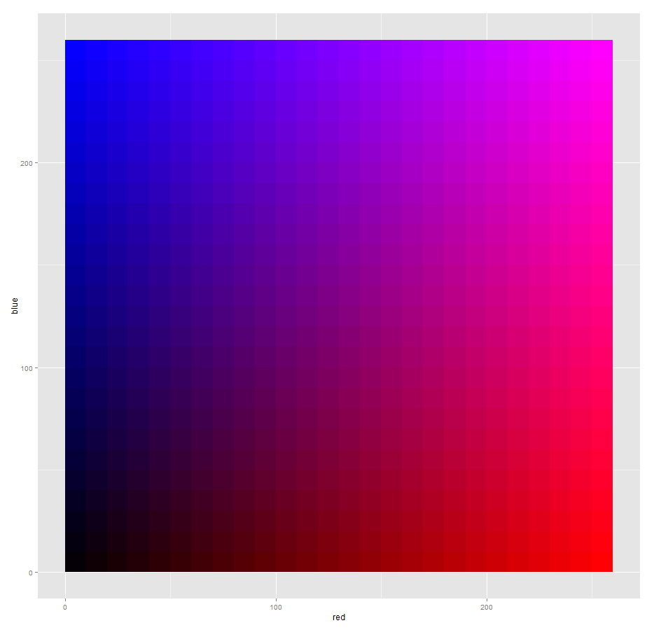

Two-mean map
Statistics:
Correlation
Not much details
Calculate the colors by their percentages in both means.
Ideas:
Progressive colors changing from blue (first selected travel mean) to red (second selected travel mean).
Color-blindness considered
Legend is customized
Outline
Motivation
An Example
Background
Concept of the app
Reading Data
Preparation
Parameters
One-mean Table
One-mean Map
Two-mean Table
Scatterplot
Two-mean Map
Legend Comparison
A Little Taste
More to be done
The End
Notes:
Time: 3min
20.30
STAT:
Show correlation in physical locations by colours
Two-mean
No details displayed
Tech:
Calculating and Computing of the colours
Comparing Two legends and the difficulties of outputting them
Have got the good one, but no time for it

Slide 14
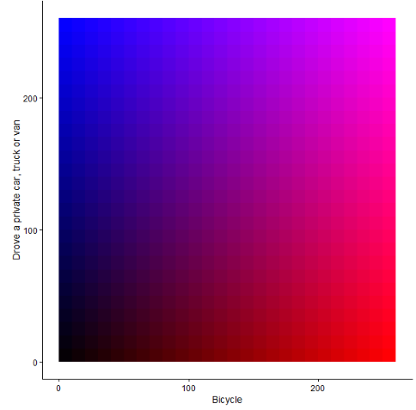
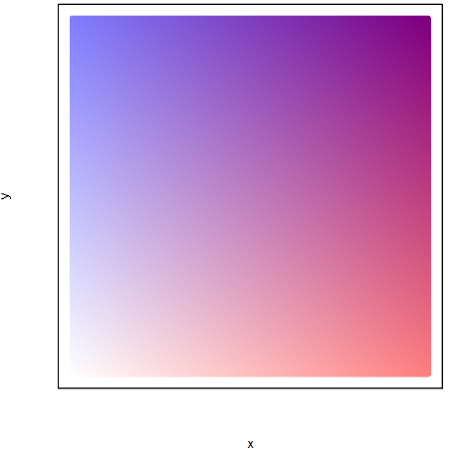
Legend comparison
(0,0,255)
Rgb:
(0,0,255)
(255,0,255)
Rgb: (255,0,255)
Outline
Motivation
An Example
Background
Concept of the app
Reading Data
Preparation
Parameters
One-mean Table
One-mean Map
Two-mean Table
Scatterplot
Two-mean Map
Legend Comparison
A Little Taste
More to be done
The End
(255,0,255)
Rgb:
(255,0,255)
(0,0,255)
Rgb:
(0,0,255)
(0,0,0)
Rgb: (0,0,0)
(255,0,0)
Rgb: (255,0,0)
(0,0,0)
Rgb: (255,255,255)
(255,0,0)
Rgb: (255,0,0)
Notes:
Time: 1min
21.30

Slide 15
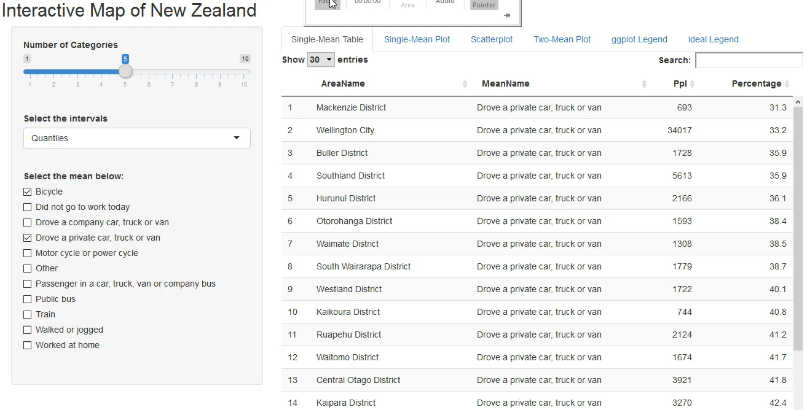
A little taste
Outline
Motivation
An Example
Background
Concept of the app
Reading Data
Preparation
Parameters
One-mean Table
One-mean Map
Two-mean Table
Scatterplot
Two-mean Map
Legend Comparison
A Little Taste
More to be done
The End
Notes:
Time: 2min
24.30
Show the app

Slide 16

More to be done
Outline
Motivation
An Example
Background
Concept of the app
Reading Data
Preparation
Parameters
One-mean Table
One-mean Map
Two-mean Table
Scatterplot
Two-mean Map
Legend Comparison
A Little Taste
More to be done
The End
Better style
Correlation analysis
Interactive linear regression
Providing variables to users
Involving standard deviation
Other statistical analysis
etc.……
Notes:
Time: 3min
27.30
Correlation analysis – putting the scatterplot and map together. Highlight the corresponding TA in map when the data points are selected (multiple selection is available) in scatterplot.
This can enable users to find out if the correlation only exists in some TA which are around each other, or the TA are separated.
Interactive linear – this would have more parameters for users to use. enables

Slide 17
Hope you enjoyed it and thank you for your time!
Special thanks to Richard Penny (Supervisor)
UC staff
Statistics NZ
for the professional advices, help and the opportunity!
Outline
Motivation
An Example
Background
Concept of the app
Reading Data
Preparation
Parameters
One-mean Table
One-mean Map
Two-mean Table
Scatterplot
Two-mean Map
Legend Comparison
A Little Taste
More to be done
The End
Notes:
Time: 1min
28.30

